Slide 1

MiniMap
By:
Victor Kushnir
Porat Aharon
Andrey Bakhrakh

Slide 2

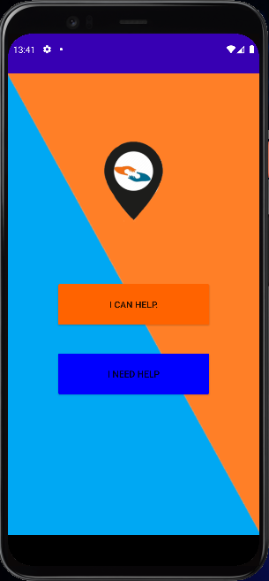
MiniMap
Location based social security network app, where every user who needs an urgent help can be assigned to the closest user willing to help.

Slide 3



Meet Our Team
Project Manager
Chief Architect
Programmer
Victor Kushnir
Porat Aharon
Andrey Bakhrakh

Slide 4

The Problem
Finding closest human support in extreme situations or in situations of a great need :
Car break in the middle of the road.
Get lost in the woods .
Pet got lost .
Ran out of toilet paper .
ETC …
Having an International support platform regardless to the country where the user is located.

Slide 5
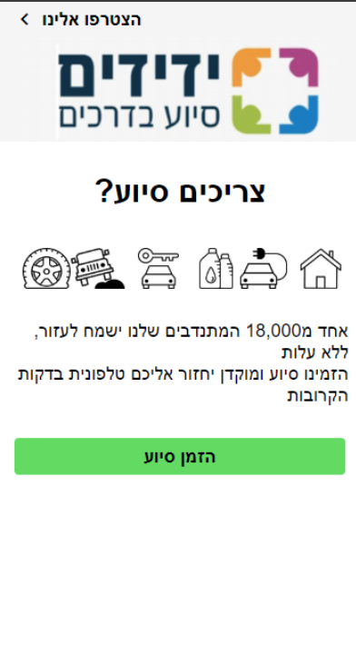
The Situation Today
Yedidim App:
Pros:
Provides a reliable network platform of users helping each other in case of need.
Cons:
Limited to Israel only , in other words, its useless in any other country.

Slide 6
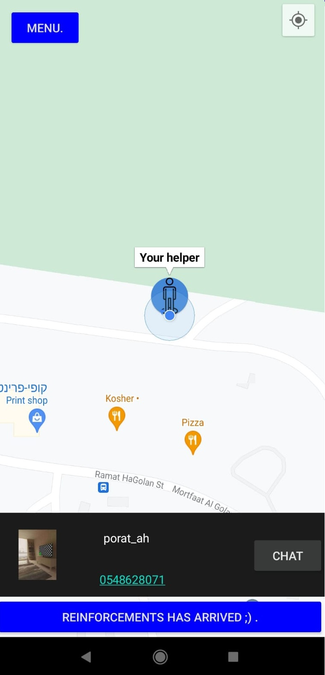
The Solution: MiniMap
International location based social security platform , where every user who needs an urgent help can be assigned to the closest user willing to help.

Slide 7
How Does It Work?
Abstract User :
Log in/Sign up.
In the menu section the requester can see his personal data, change it at the Settings section and Log out if he wishes so.

Slide 8
How Does It Work?
Requester :
Hitting the request button initializes the main core process:
Opens a request in the database assigned to the requester location.
Gets by query the closest available Helper .
Receives assigned helpers Information ,location as a map marker and opens a chatroom between the two.
Hitting the Finish button finishes the current connection activity and removes all the runtime data from the database.

Slide 9
How Does It Work?
Helper :
Marks the Helper in the HelpersAvailable section in the database.
Listen to his own section at the database to see if it got assigned for any Requester:
If it got assigned, Receives assigned helpers Information ,location as a map marker, sending its own live location coordinates and opens a chatroom between the two.
Hitting the Finish button finishes the current connection activity and removes all the runtime data from the database.

Slide 10
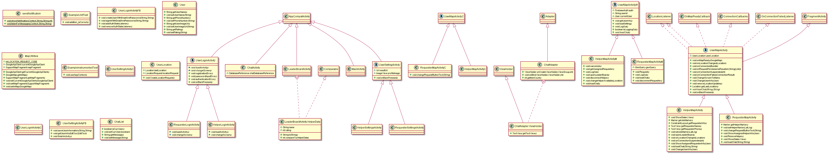
UML

Slide 11




The Project Uses The Following Systems
Firebase- Main project database.
GeoFire
GeoFire – Was used to perform real-time location queries with Firebase.
Google Maps API – Was used for more intuitive and user-friendly layout.
Glide – Was used as a fast and efficient media management and image loading framework for Android that wraps media decoding, memory and disk caching, and resource pooling into a simple and easy to use interface.

Slide 12
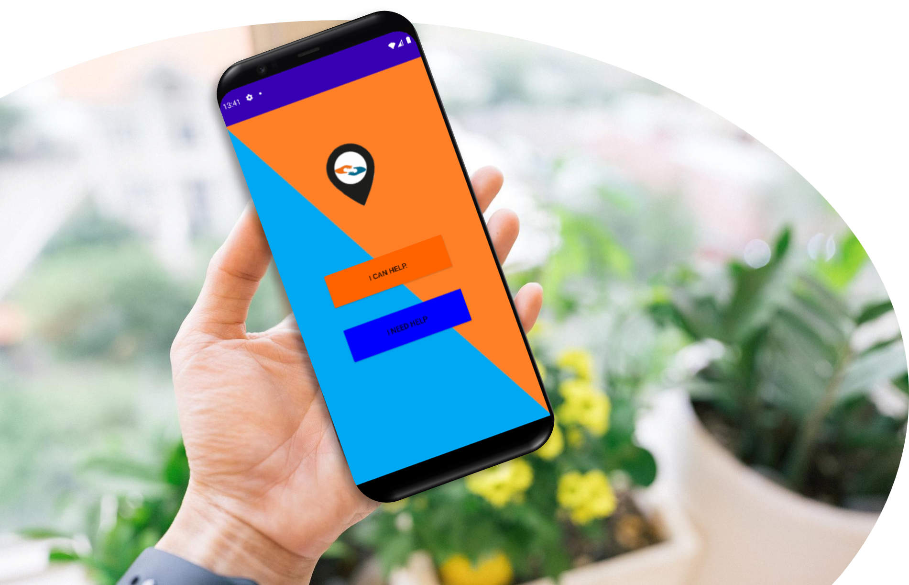
App Features
Fast Closest Available Helper Identification.
Bidirectional Live Location Share.
Relative Information Share.
Easy To Use Chatroom.
User Friendly Interface.
Top Rated Helpers Show List.
Message Receiving/Partner Assignment Notification.

Slide 13
App Features
Fast Closest Available Helper Identification
Starts searching at the HelpersAvailable database, at first queries those who are in radius 1 km, if those does not exist the radius increases by 1.
The Helper Changes its database category to HelpersBusy.
After assignment, the helpers receives Requesters Information, live location and a link to a unique chatroom as well as the Requester receives Helpers Information, live location and a link to a unique chatroom.

Slide 14
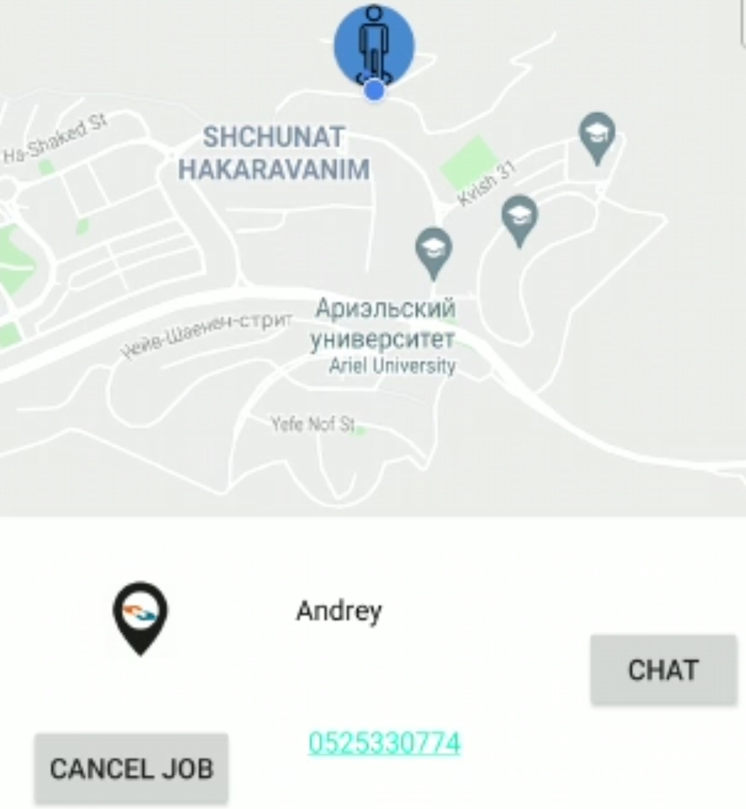
App Features
Bidirectional Live Location Share
After assignment, both the Requester and the Helper start to send their live location to the database whereas the other side, listens to those parameters and representing the graphically using map Markers.

Slide 15
App Features
Relative Information Share
After assignment, both the Requester and the Helper read their partners information in order to receive the name and the phone number in case the internet connection which is needed for the chat is unstable.

Slide 16
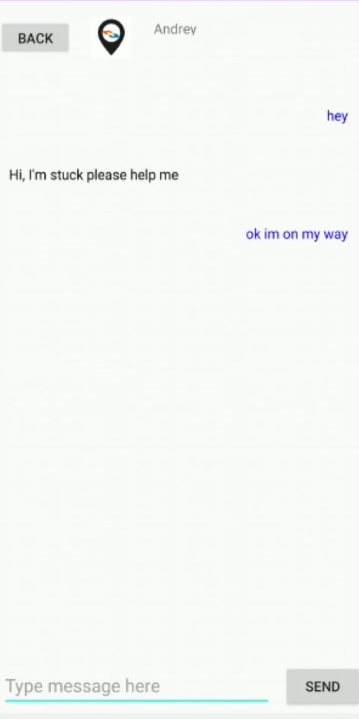
App Features
Easy To Use Chatroom
After assignment, both the Requester and the Helper receives a unique chatroom, where the receiving side gets also a notification for every message it acquires.

Slide 17
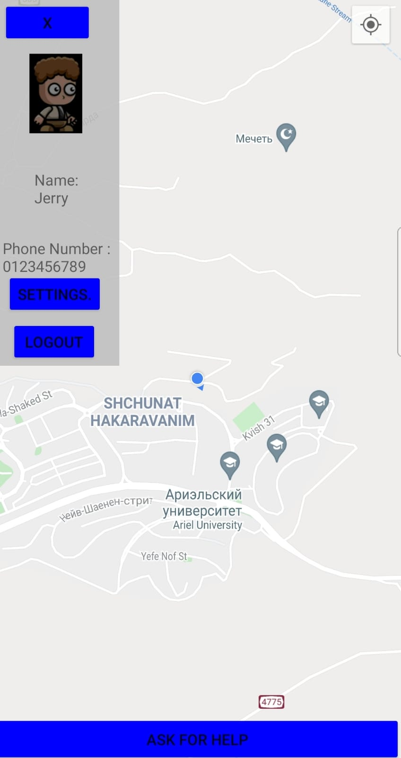
App Features
User Friendly Interface

Slide 18
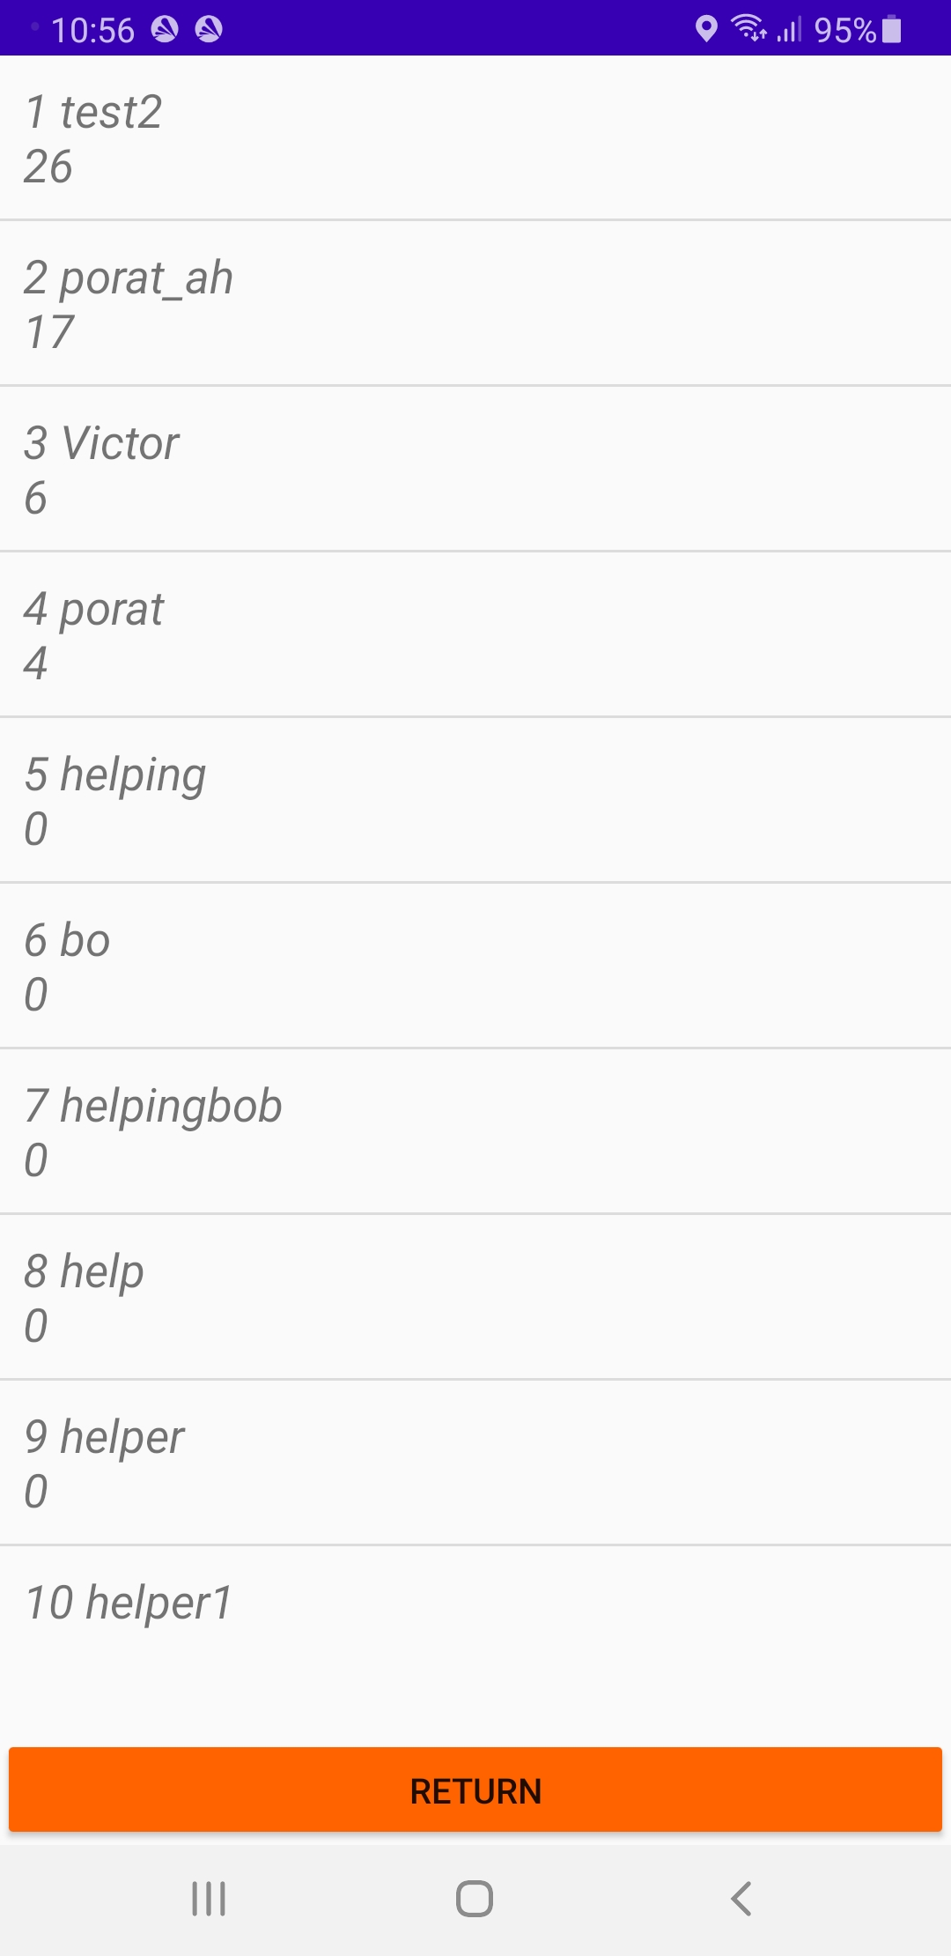
App Features
Top Rated Helpers Show List
Every Helper, after it get assigned to a Requester and marked as Finished by the requester gets an increase of 1 point to its rating database attribute, every helper can see its own rating in the menu section and see the best helpers in the platform, which are being chosen by the highest rating.

Slide 19

App Features
Message Receiving/Partner Assignment Notification
After assignment, both the Requester and the Helper receives a notification about the new assignment, both receives a relevant notification after receiving a message in the chat.

Slide 20
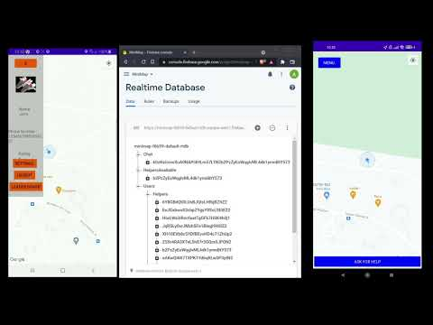
Application PoC video

Slide 21
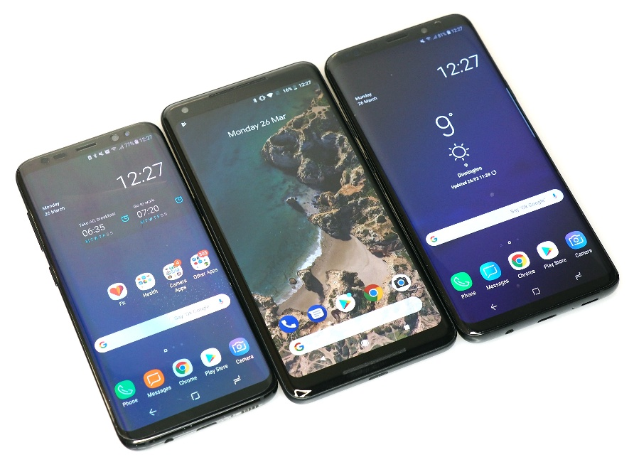
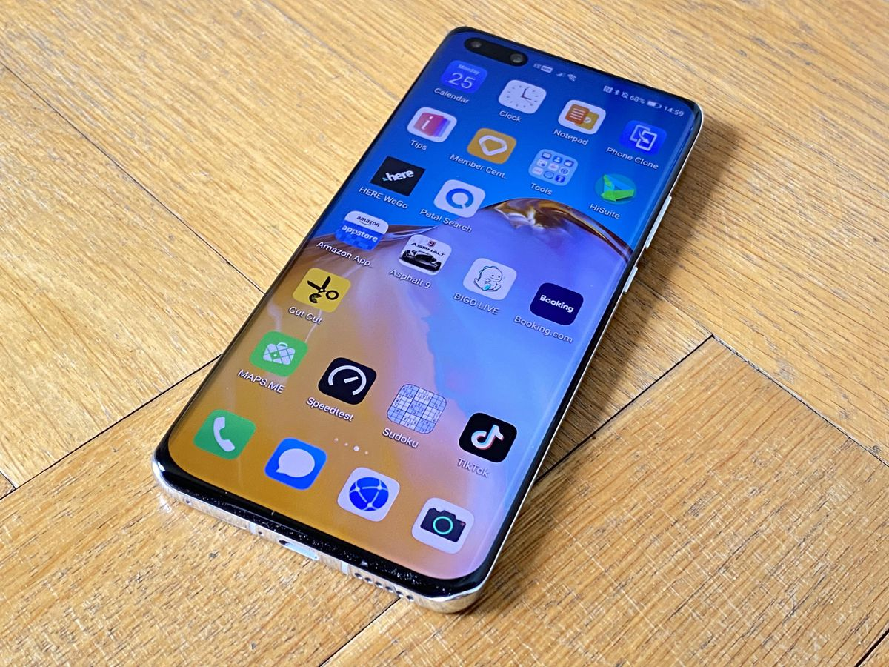
Further development features
Chat history section.
Donation.
Videocalls .
Visualization of everybody around.
Creation of moderator user type.
Apple devices compatibility.
Helper search by request priority.
Application version verification and update control system.
Helpers specific reviews made by the requesters.

Slide 22
Information
Organization : V-P-A-AppDev
Project repository: MiniMap
Team:
1. VictoKu1
2. porat-ah
3. Andrey-Ba

Slide 23
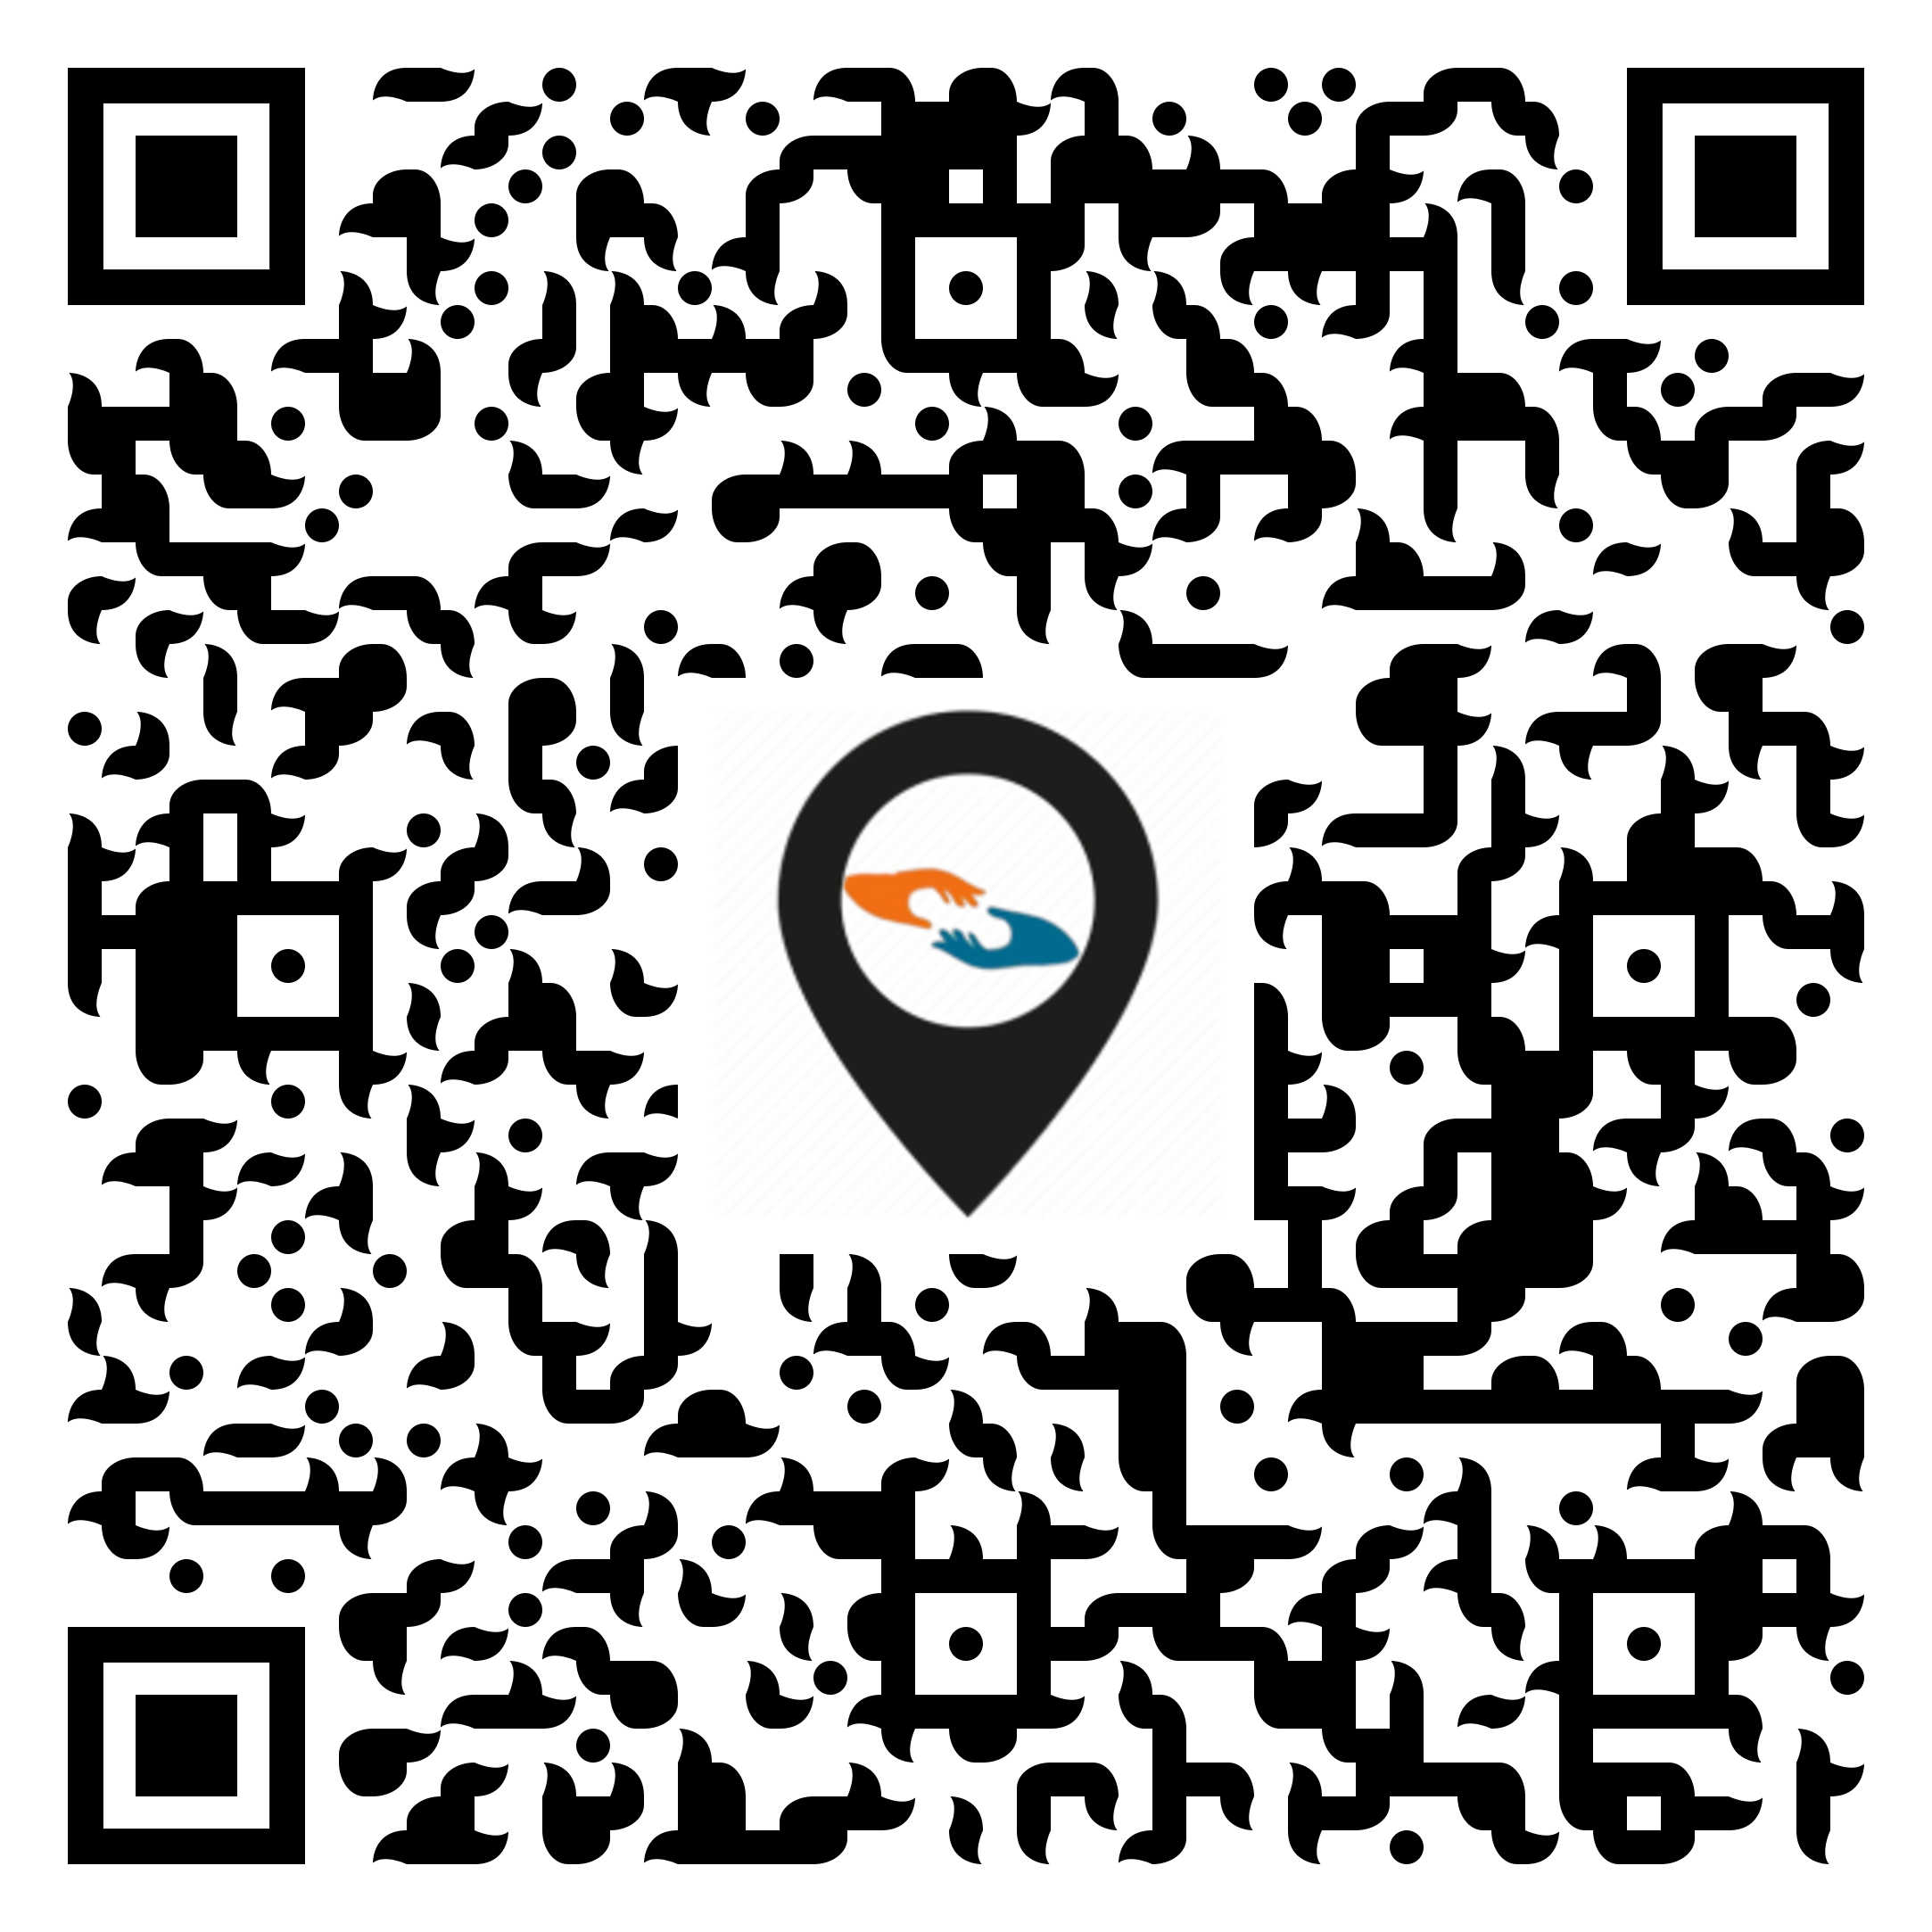
Just try the app yourself :

Slide 24
Do you have any Questions?

Slide 25


Thank You

